Slide 1
United Millennium Development Goals
R Implementation of ARIMA, XGBAR, ETS and Nnet model

Slide 2
Introduction to Problem Statement
Since 1944, world bank has been gathering data to help alleviate poverty by focusing on foreign investment, international trade, and capital investment.
The data collected is an indicator of the progress of social goals like achieve universal primary education, ensure environmental sustainability, promote gender equality and empower women etc
The data is available for the years 1972 to 2007 on over 1200 macroeconomic indicators in 214 countries around the world. The World Bank provides these data to the public through their data portal.

Slide 3
Millennium Development Goals
Achieve universal primary education
Ensure environmental sustainability
Improve maternal health
Reduce child mortality
Combat HIV/AIDS
Promote gender equality and empower women
Eradicate extreme poverty and hunger
Combat malaria and other diseases

Slide 4
Millennium Development Goals
There are a set of indicators from the World Bank dataset that represent our progress towards these goals. The goal of the project is identify these goals from the dataset, gather the data from the World Bank’s online portal, come up with an approach to handle missing data, carefully collect and rigorously analyze the past observations of the time series from the World Bank to develop an appropriate model which describes the inherent structure of the series, predict future values for the series using this model. and predict the value of the indicators for the years 2008 to 2012.

Slide 5
How to solve this problem?
A time series is a sequential set of data points, measured typically over successive times. It is mathematically defined as a set of vectors x(t),t = 0,1,2,... where t represents the time elapsed [21, 23, 31]. The variable ) x(t is treated as a random variable. . The measurements taken during an event in a time series are arranged in a proper chronological order.)
A time series containing records of a single variable is termed as univariate. But if records of more than one variable are considered, it is termed as multivariate.

Slide 6
How to solve this problem?
The general tendency of a time series to increase, decrease or stagnate over a long period of time is termed as Secular Trend or simply Trend.
Seasonal variations in a time series are fluctuations within a year during the season. The important factors causing seasonal variations are: climate and weather conditions, customs, traditional habits, etc.
Since we are dealing with data dealing with social goals, we analyzed and found that there no seasonal variations in the data. We could only find a trend.

Slide 7
ARIMA Model
The basic assumption made to implement this model is that the considered time series is linear and follows a particular known statistical distribution, such as the normal distribution. Auto Regressive Integrated Moving Average
The popularity of the ARIMA model is mainly due to its flexibility to represent several varieties of time series with simplicity. [6, 21, 23]
However, the severe limitation of these models is the pre-assumed linear form of the associated time series which becomes inadequate in many practical situations.

Slide 8
Artificial neural networks (ANNs)
These models have attracted increasing attentions in the domain of time series forecasting [8, 13, 20].
The excellent feature of ANNs, when applied to time series forecasting problems is their inherent capability of non-linear modeling, without any presumption about the statistical distribution followed by the observations.
The appropriate model is adaptively formed based on the given data. Due to this reason, ANNs are data-driven and self-adaptive by nature [5, 8, 20].

Slide 9
Gradient Boosting Model
XGBoost is short for “Extreme Gradient Boosting”. XGBoost is used for supervised learning problems, where we use the training data (with multiple features) xi o predict a target variable yi.
The forecastxgb package in R aims to provide time series modelling and forecasting functions that combine the machine learning approach of xgboost with the convenient handling of time series data.

Slide 10
ETS Model
Exponential Smoothing is a technique to make forecasts by using a weighted mean of past values, wherein more recent values are given higher weights
While running the models on the huge dataset, we realized that some of the models were not preforming very well due to the nature of data being non-stationary.
The ETS models with seasonality or non-damped trend help to account for such variations.
Thus for seasonal nature of datasets, there are a large number of restrictions on the ARIMA parameters which can be relaxed by using ETS model with the forcast() function in R.

Slide 11
Technologies Used:
R
Spark
HDFS
Elasticsearch
Kibana for graphs

Slide 12
What was provided ?
We were given a World bank data which had indicators in it from 1970 to 2007
The data was of different goals for different countries through out the world

Slide 13
What was Accomplished?
We did normalization of data which we got from World bank
We did prediction from 2007 to 2012 of all the countries of all the goals and indicators provided

Slide 14
Results : Actual and Predicted values

Slide 22
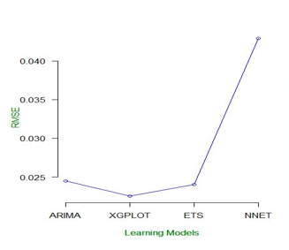
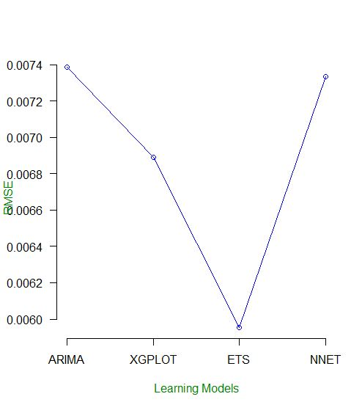
RMSE 2.1 and 3.2

Slide 23
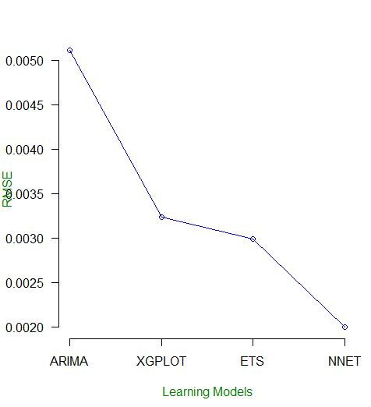
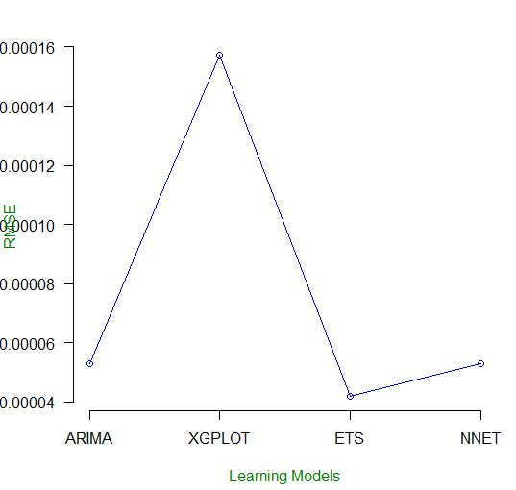
RMSE 4.1 and 5.1

Slide 24
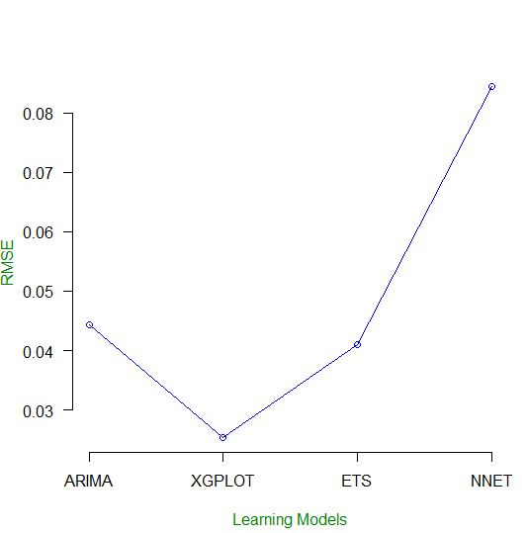
RMSE 8.16

Slide 25
Conclusion
Based on the observations from the plotted graphs for all the cases we can summarize the analysis as follows:
The predicted values are very similar to actual values and they follow the graph
Predicted values for different models resembles each other

Slide 26
Thank you

